Slide 1

A Project PPT On
Prediction Of Chronic Kidney Disease Using Different Machine Learning Algorithms
Bachelor of Technology
in
Artificial Intelligence and Machine Learning
Under the Esteemed Supervision of
Mr. K N S K Santhosh. M.Tech
Assistant Professor
Submitted by
20MH1A4210 - Eethakota Ayyappa Karthik
20MH1A4239 - Mutha Surya Bhavani
20MH1A4252 - Singineedi Charan Sagar Aswanth
20MH1A4263 - Vikas Sai Kumar Balla
Department of CSE ( AI & ML / IOT )
Aditya College Of Engineering

Slide 2
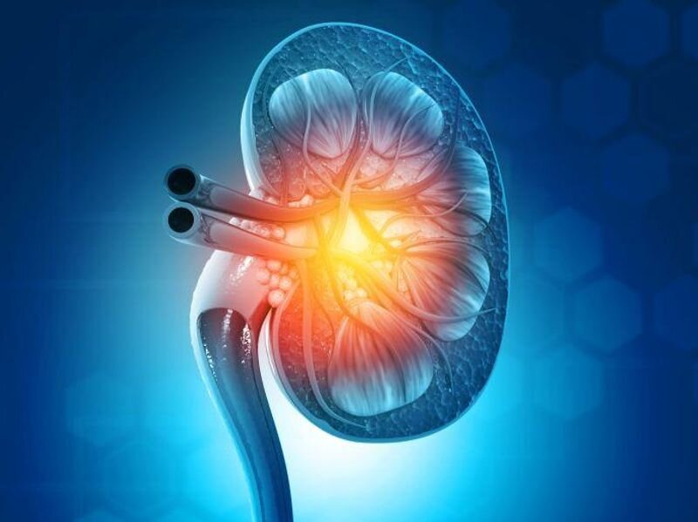
Outline :-
Abstract
Introduction
Literature Review
Symptoms
Causes
Risk Factors
Stages Of Chronic Kidney Disease
Preventions
Motivation / Background
Objectives
References

Slide 3
Abstract
Chronic Kidney Disease (CKD) or chronic renal disease has become a major issue with a steady growth rate. A person can only survive without kidneys for an average time of 18 days, which makes a huge demand for a kidney transplant and Dialysis. It is important to have effective methods for early prediction of CKD. Machine learning methods are effective in CKD prediction. This work proposes a workflow to predict CKD status based on clinical data, incorporating data prepossessing, a missing value handling method with collaborative filtering and attributes selection. Out of the 11 machine learning methods considered, the extra tree classifier and random forest classifier are shown to result in the highest accuracy and minimal bias to the attributes. The research also considers the practical aspects of data collection and highlights the importance of incorporating domain knowledge when using machine learning for CKD status prediction

Slide 4

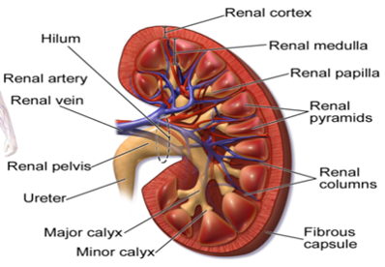
Introduction
Chronic kidney disease, also called chronic kidney failure, involves a gradual loss of kidney function.
Your kidneys filter wastes and excess fluids from your blood, which are then removed in your urine.
Advanced chronic kidney disease can cause dangerous levels of fluid, electrolytes and wastes to build up in your body
As the past records show, the number of deaths in India due to chronic kidney disease (CKD) were 5.21 million in 2008
There is need of detection of the chronic kidney disease at early stage before getting it worse

Slide 5
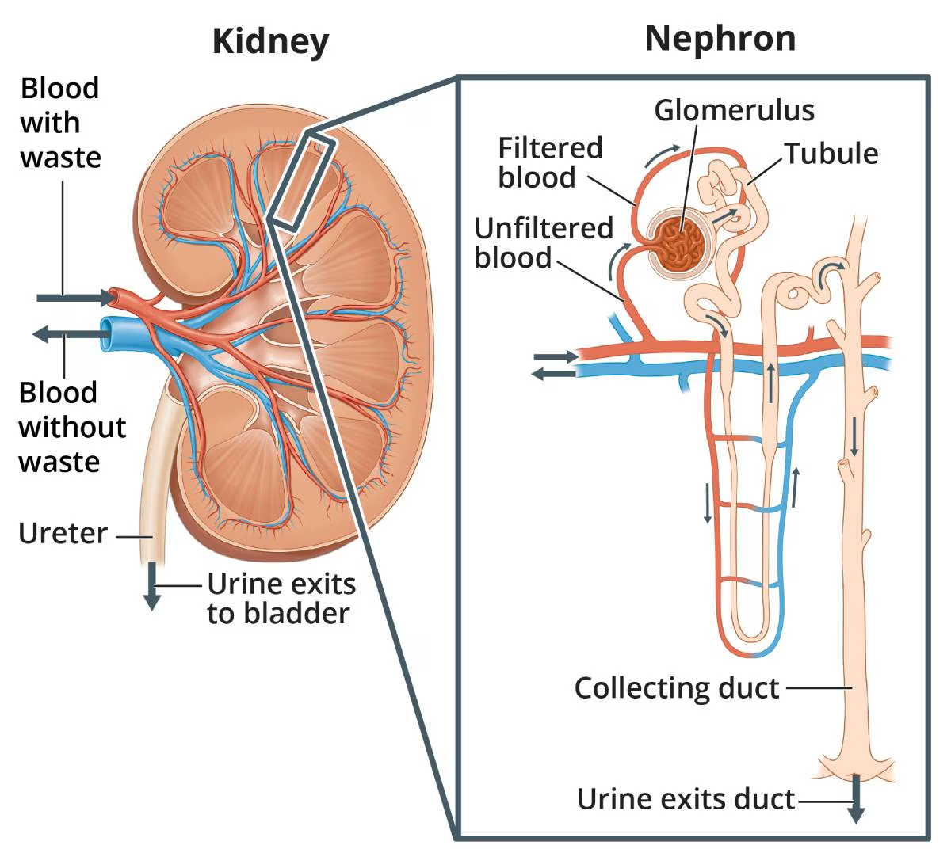
In the early stages of chronic kidney disease, you might have few signs or symptoms. You might not realize that you have kidney disease until the condition is advanced.
Treatment for chronic kidney disease focuses on slowing the progression of kidney damage, usually by controlling the cause. But, even controlling the cause might not keep kidney damage from progressing.
Chronic kidney disease can progress to end-stage kidney failure, which is fatal without artificial filtering (dialysis) or a kidney transplant.

Slide 6
Literature Review
The research to detect CKD with ML algorithms has enhanced the procedure and consequence accuracy progressively. They proposed the random forest classifier (99.75% accuracy) as the maximum efficient classifier among all other classifiers.
The study demonstrates the effective handling of missing values in data through four techniques, namely, mode, mean, median, and zero-point methods.
Overall, the motive of the study is to examine the applicability of specific supervised machine learning classifiers in the field of bioinformatics and offer their compatibility in detecting several serious diseases such as the diagnosis of CKD at an early stage

Slide 7
Symptoms
Signs and symptoms of chronic kidney disease develop over time if kidney damage progresses slowly. Loss of kidney function can cause a buildup of fluid or body waste or electrolyte problems. Depending on how severe it is, loss of kidney function can cause
Nausea
Vomiting
Loss of appetite
Fatigue and weakness
Sleep problems
Urinating more or less
Decreased mental sharpness
Muscle cramps
Swelling of feet and ankles
Dry, itchy skin
High blood pressure (hypertension) that's difficult to control
Shortness of breath, if fluid builds up in the lungs
Chest pain, if fluid builds up around the lining of the heart

Slide 8
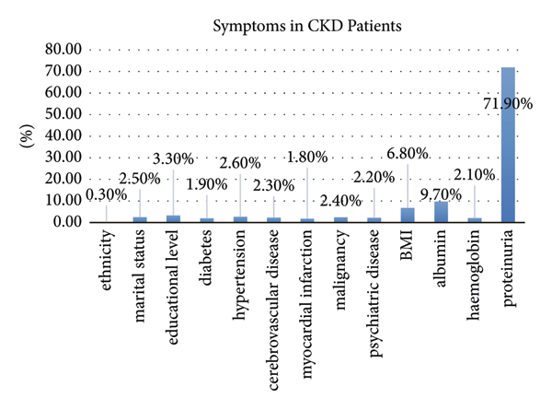

Slide 9
Causes
Chronic kidney disease occurs when a disease or condition impairs kidney function, causing kidney damage to worsen over several months or years.
Diseases and conditions that cause chronic kidney disease include:
Type 1 or type 2 diabetes
High blood pressure
Glomerulonephritis , an inflammation of the kidney filtering units (glomeruli)
Interstitial nephritis , an inflammation of the kidney tubules and surrounding structures
Polycystic kidney disease or other inherited kidney diseases
Prolonged obstruction of the urinary tract, from conditions such as enlarged prostate, kidney stones and some cancers
Vesicoureteral reflux, a condition that causes urine to back up into your kidneys
Recurrent kidney infection, also called pyelonephritis

Slide 10
Risk Factors
Factors that can increase your risk of chronic kidney disease include:
Diabetes
High blood pressure
Heart (cardiovascular) disease
Smoking
Obesity
Being Black, Native American or Asian American
Family history of kidney disease
Abnormal kidney structure
Older age
Frequent use of medications that can damage the kidneys

Slide 11
Five stages of chronic kidney disease
Doctors determine the stage of kidney disease using the glomerular filtration rate (GFR), a math formula using a person's age, gender, and their serum creatinine level (identified through a blood test).
Stage 1 :- with normal or high GFR (GFR > 90 mL/min)
Stage 2 :- Mild CKD (GFR = 60-89 mL/min)
Stage 3A :- Moderate CKD (GFR = 45-59 mL/min)
Stage 3 B :- Moderate CKD (GFR = 30-44 mL/min)
Stage 4 :- Severe CKD (GFR = 15-29 mL/min)
Stage 5 :- End Stage CKD (GFR <15 mL/min)

Slide 12
Prevention
To reduce your risk of developing kidney disease:
Follow instructions on over-the-counter medications :-
When using non prescription pain relievers, such as aspirin, ibuprofen (Advil, Motrin IB, others) and acetaminophen (Tylenol, others), follow the instructions on the package. Taking too many pain relievers for a long time could lead to kidney damage.
Maintain a healthy weight :-
If you're at a healthy weight, maintain it by being physically active most days of the week. If you need to lose weight, talk with your doctor about strategies for healthy weight loss.
Don't smoke :-
Cigarette smoking can damage your kidneys and make existing kidney damage worse. If you're a smoker, talk to your doctor about strategies for quitting. Support groups, counseling and medications can all help you to stop.
Manage your medical conditions with your doctor's help :-
If you have diseases or conditions that increase your risk of kidney disease, work with your doctor to control them. Ask your doctor about tests to look for signs of kidney damage.

Slide 13
Motivation / Background
Chronic Kidney Disease (CKD) is one of the most deadly non-communicable diseases globally.
In 2017, the total number of worldwide deaths due to CKD was 1.2 million which rose to 41.5% from 1990.
The global burden of CKD is increasing, and is projected to become the 5th most common cause of years of life lost globally by 2040.
In CKD, kidney unable to perform essential functions in the body which leads to other critical diseases such as heart disease, high blood pressure, diabetes etc.
Therefore, early-stage detection of CKD is essential for containing the further progression of the disease, which in turn reduce the mortality rate and treatment cost significantly.

Slide 14
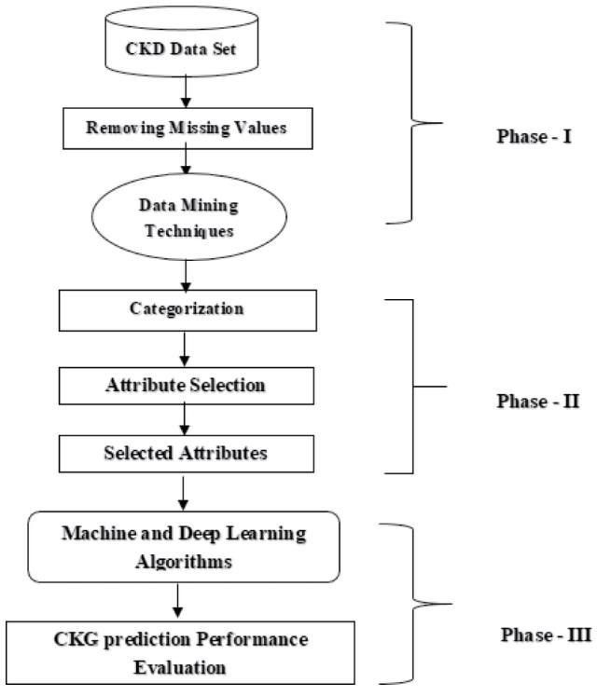
Block diagram Of Chronic Kidney Disease Prediction

Slide 15
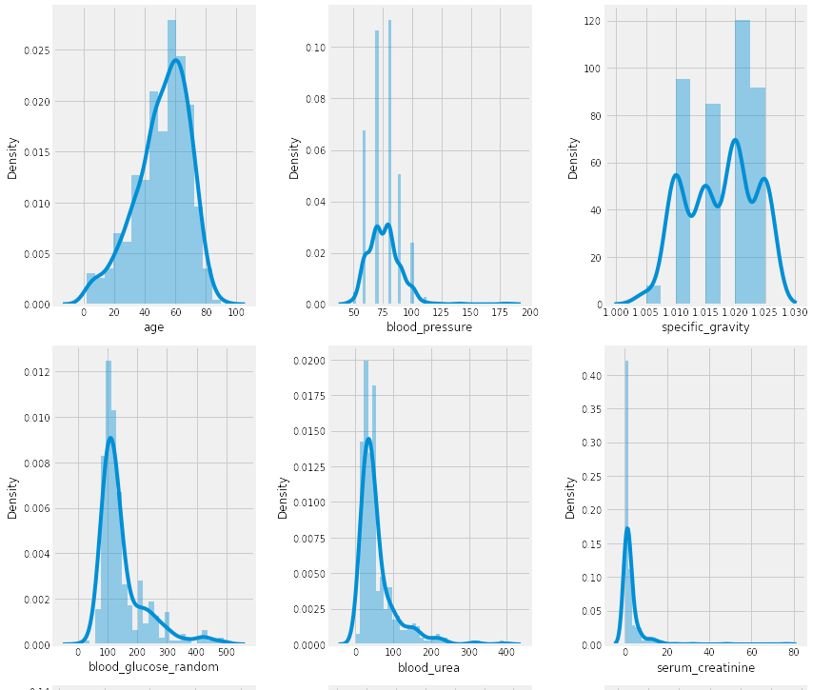
Feature Distribution

Slide 16
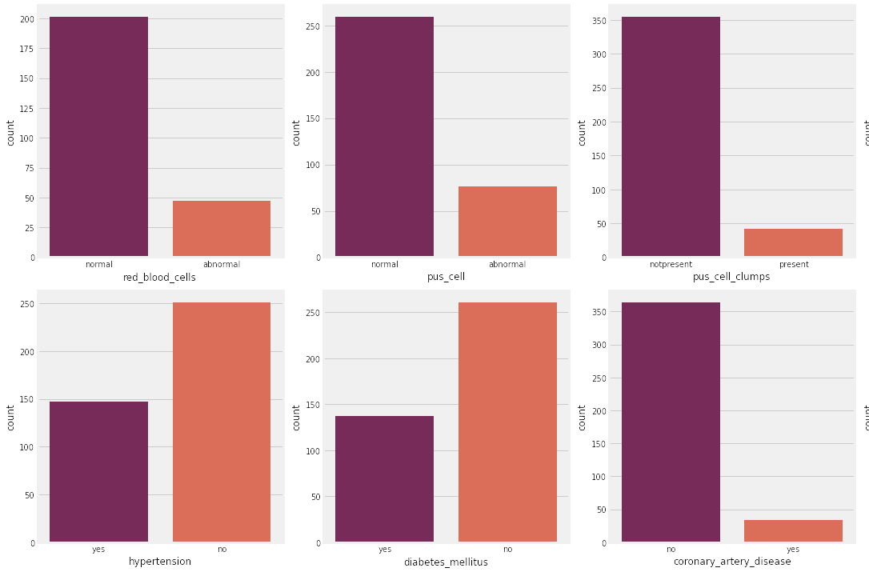
Categorical Columns

Slide 17
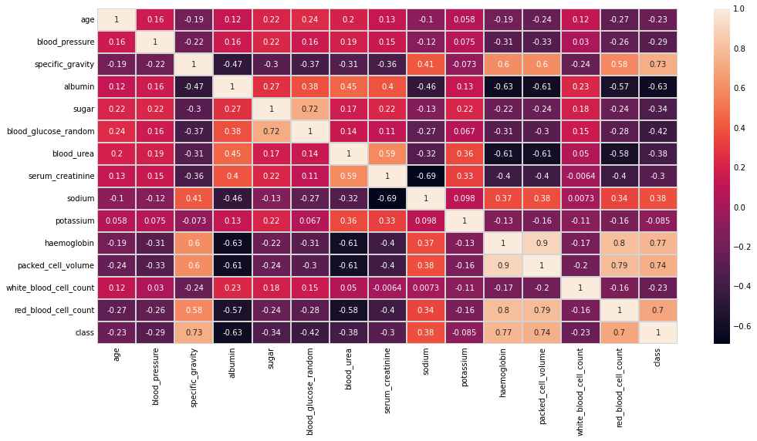
Heat Map

Slide 18
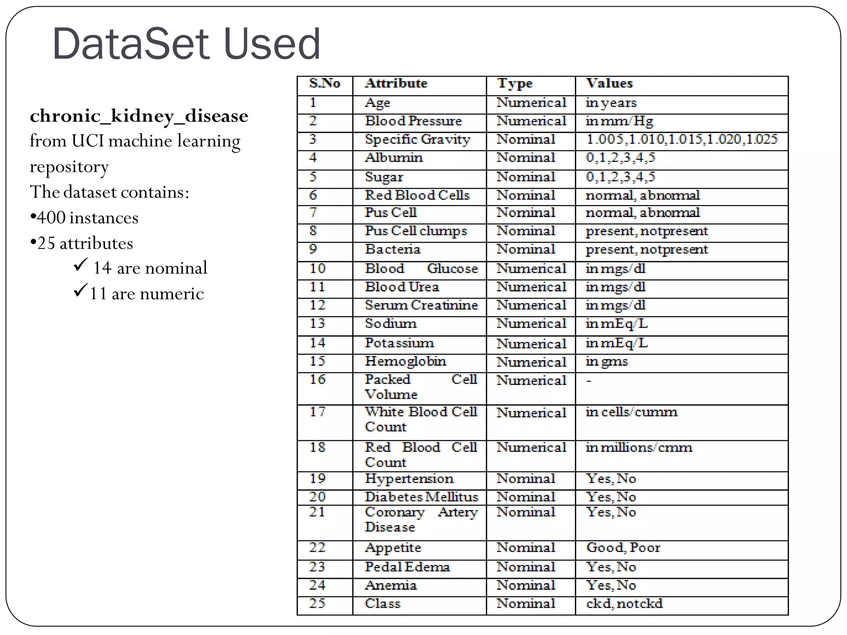

Slide 19
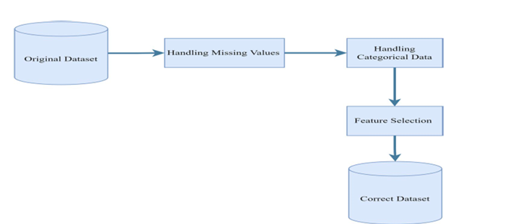
Data Preprocessing

Slide 20
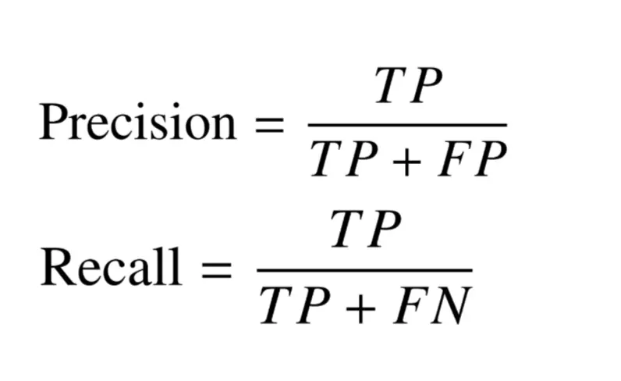
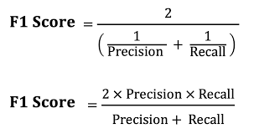
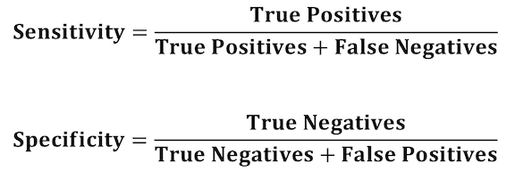
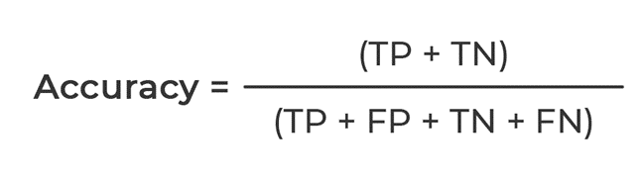
Formulas that we used for Calculation :-

Slide 21
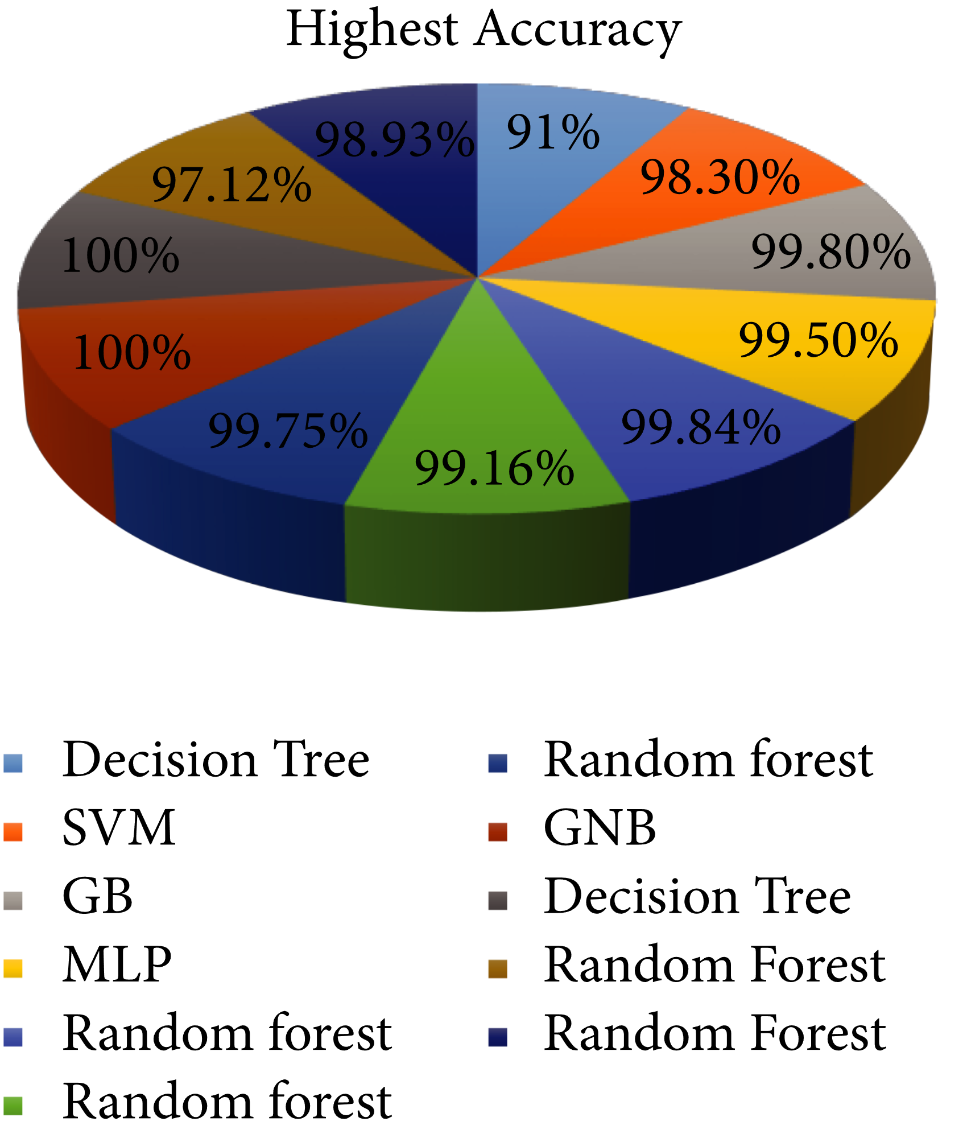
Comparison of machine learning classifiers.
S.no Classifier Accuracy %
1. Decision Tree 91%
2. SVM 98.3%
3. Random Forest 99.84%

Slide 22
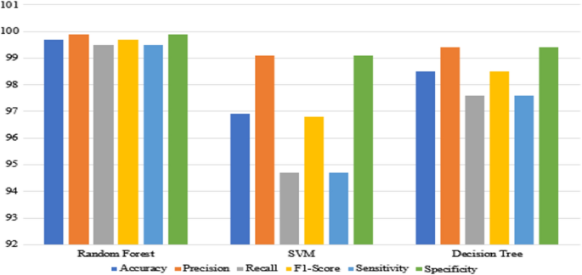
Accuracy , Precision , Recall , F1-Score

Slide 23
Future Works :-
This study used a supervised machine-learning algorithm, feature selection methods to select the best subset features to develop the models. It is better to see the difference in performance results using unsupervised or deep learning algorithms models. The proposed model supports the experts to give the fast decision, it is better to make it a mobile-based system that enables the experts to follow the status of the patients and help the patients to use the system to know their status

Slide 24
Conclusion :-
Early prediction is very crucial for both experts and patients to prevent and slow down the progress of chronic kidney disease to kidney failure. In this study three machine learning models RF, SVM, DT were used to build proposed models. The evaluation of models were done using tenfold cross validation. First, the three machine learning algorithms were applied to original datasets with all 19 features. Applying the models on the original dataset, we have got the highest accuracy with RF, SVM . The accuracy was 99.84% by using random forest . And with the Support Vector Machine the accuracy was 98.3% . And with the least which was decision tree which was accuracy of 91%

Slide 25
References :-
K. B. Naidu, B. R. Prasad, S. M. Hassen, et al., “Analysis of Hadoop log file in an environment for dynamic detection of threats using machine learning,” Elsevier Measurement: Sensors, vol. 24, pp. 1–5, 2022.
E. Dritas and M. Trigka, “Machine learning techniques for chronic kidney risk prediction,” Big Data and Cognitive Computing, pp. 1–15, 2022.
U. Ekanayake and D. Herath, “Chronic kidney disease prediction using machine learning methods,” in Proc. 2020 Moratuwa Engineering Research Conference (MERCon), 2020, pp. 260–265.
Your Kidneys & How They Work. NIDDK. [Online]. Available: https://www.niddk.nih.gov/health information/kidneydisease/kidneys-how-they-work
Kidney disease: The basics. (Aug. 2014). [Online].
Available: https://www.kidney.org/news/newsroom/factsheets/KidneyDiseas eBasics
Global facts: About kidney disease. [Online].
Available: https://www.kidney.org/kidneydisease/global-facts-about kidneydisease/
Facts about chronic kidney disease. (May 2020). [Online].
Available: https://www.kidney.org/atoz/content/about-chronic kidney-disease
J. Xiao, R. Ding, X. Xu, H. Guan, X. Feng, T. Sun, S. Zhu, and Z. Ye, “Comparison and development of machine learning tools in the prediction of chronic kidney disease progression,” Journal of Translational Medicine, vol. 17, no. 1, p. 119, 2019.
[9] E.-H. A. Rady and A. S. Anwar, “Prediction of kidney disease stages using data mining algorithms,” Informatics in Medicine Unlocked, vol. 15, 100178, 2019

Slide 26
Thank You

